Slide 1
MongoDB

Slide 2
MongoDB
Cross-platform, document-oriented database.
Leading modern, general purpose database platform.
Designed for ease of development and scaling.
Developed by MongoDB Inc. and licensed under the Server Side Public
License (SSPL).
Classified as a NoSQL database.

Slide 3
MongoDB
MongoDB has improved performance
Makes data storage faster and easier by using dynamic database schemas similar to JSON instead of traditional relational database systems of tables and SQL.
Dynamic database schema used is called the BSON.

Slide 4
MongoDB
MongoDB was founded in 2007 by Dwight Merriman, Eliot Horowitz and Kevin Ryan – the team behind DoubleClick.
Internet advertising company DoubleClick (now owned by Google), the team developed and used many custom data stores to work around the shortcomings of existing databases.
The business served 400,000 ads per second, but often struggled with both scalability and agility.
Frustrated, the team was inspired to create a database that tackled the challenges it faced at DoubleClick.This was when MongoDB was born.

Slide 5
MongoDB
Why is MongoDB a NoSQL database?
Because it does not utilize tables, rows and columns to organize data.
b) Because it uses a structured way to store and access data
Both a) and b)

Slide 6
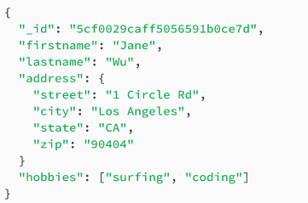
Mongo – Document Database
A record in MongoDB is a document, which is a data structure composed of field and value pairs .
MongoDB documents are similar to JSON Objects.
The value of the field may include other documents, arrays and array of documents.
_id field,primary key
Field : Value
Attribute pointing to another document
Hobbies stored as array of strings

Slide 7
JSON – JavaScript Object Notation
Lightweight data-interchange format.
It is easy for humans to read and write.
It is easy for machines to parse and generate.
It is based on a subset of the JavaScript Programming Language Standard ECMA-262 3rd Edition.
Commonly used for API s and configs

Slide 8
JSON – JavaScript Object Notation
In JSON file,the data inside are represented in a key:value pair, just like a traditional
JavaScript object.
JSON and objects aren't exactly the same.
The core difference is that the key in JSON must be in double-quotes, and the values apart
from the number and null types must be in double-quotes, too.

Slide 9
JSON – JavaScript Object Notation
JSON's basic data types
Number : a signed decimal number that may contain a fractional part and may use exponential E notation, but cannot include non-numbers such as NaN.
String : a sequence of zero or more Unicode characters. Strings are delimited with double-quotation marks and support a backslash escaping syntax.
Boolean : either of the values true or false
Array : an ordered list of zero or more elements, each of which may be of any type. Arrays use square bracket notation with comma-separated elements.
Object : a collection of field –value pairs where the field(also called keys) are strings. Each key is unique within an object.
Null : an empty value, using the word null

Slide 10
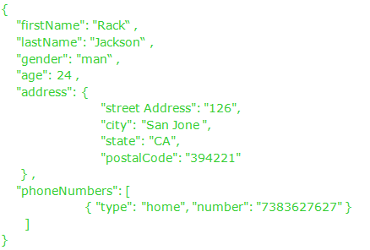
JSON – JavaScript Object Notation
Example

Slide 11
BSON
Binary Javascript Object Notation- BSON.
It is a binary-encoded serialization of JSON documents.
BSON has been extended to add some optional non-JSON-native data types, like dates and
binary data.
BSON has a published specification : https://bsonspec.org/spec.html

Slide 12
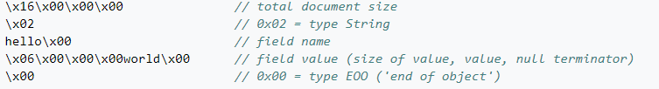
BSON
Example : A document such as {"hello":"world"} will be stored as:

Slide 13
MongoDB Features
Ad–hoc queries
Document Data model
Indexes
Replication
Speed and Durability
Scaling

Slide 14
Database, Collection and Documents
Database is a physical container for collections. Each database gets its own set of files on the file system. A single MongoDB server typically has multiple databases.
Collections is a group of MongoDB documents. It is the equivalent of an RDBMS table.
A collection exists within a single database. Collections do not enforce a schema. Documents within a collection can have different fields.
Document is a set of key-value pairs. Documents have dynamic schema.

Slide 15
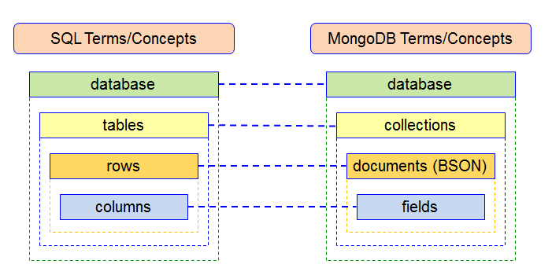
Database, Collection and Documents

Slide 16
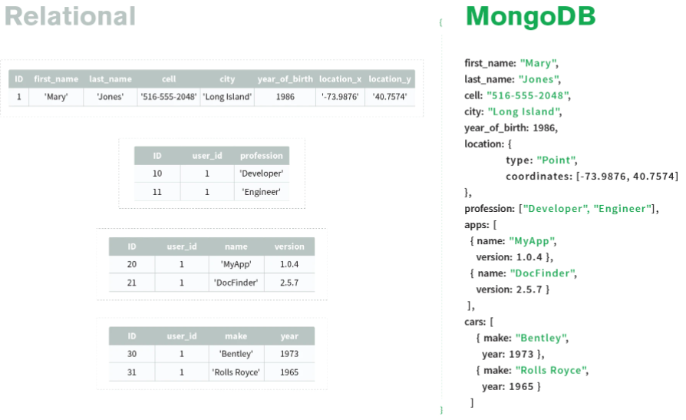
Database, Collection and Documents

Slide 17
Database, Collection and Documents
Select the statements that together help build the most complete definition of the MongoDB database:
MongoDB database is an organized way to store and access data.
b) MongoDB database organizes documents in rows and columns
c) MongoDB's database uses tables of related data.
d) MongoDB is a NoSQL database that uses documents to store data in an organized way.
Both a) and d)

Slide 18
Database, Collection and Documents
In MongoDB how does a document relate to a collection?
Documents are made up of collections.
b) Collections consist one or many documents.
Collections are documents that are organized in rows and columns.
Collections are tables of documents and other collections.
b)

Slide 19
Database, Collection and Documents
In a MongoDB Document what is the role of fields and values?
A field is a unique identifier for a specific datapoint.
Values do not have to be attached to fields, and can be stand alone data points.
Each field has a value associated with it.
Both a) and c)

Slide 20
Database, Collection and Documents
Which of the following documents is correct JSON?
["name" : "Devi", "age": 19, "major": "Computer Science"]
{name : "Devi", age: 19, major: "Computer Science"}
{"name" : "Devi", "age": 19, "major": "Computer Science"}
b) And c)

Slide 21
Database, Collection and Documents
Write BSON or JSON in the numbered blanks in the following sentences to make them true:
MongoDB stores data in 1……….. and you can then view it 2……….
3……….. is faster to parse and lighter to store than 4……….
5……….. supports fewer data types than 6………..
1.BSON 2.JSON
3.BSON 4.JSON
5.JSON 6.BSON

Slide 22
Environment – Install and configure MongoDB
MongoDB is available in two server editions: Community and Enterprise.
To install Community MongoDB on Windows, download the latest release(5.0.2(current)) with below link
https://www.mongodb.com/try/download/community
The below link describes how to install MongoDB locally
https://docs.mongodb.com/guides/server/install/

Slide 23
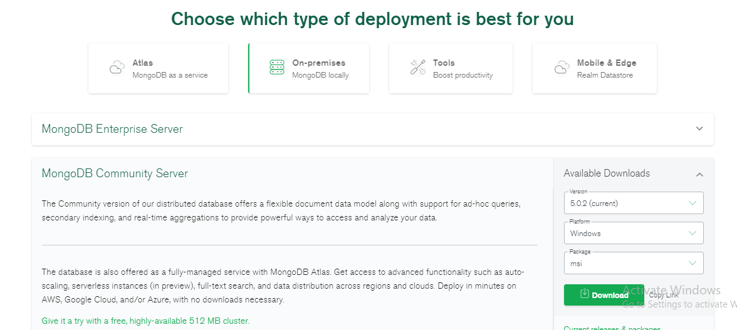
Environment – Install and configure MongoDB
Click the numbers in order to download the mongodb community server from the link specified in the previous page
1
2
3

Slide 24
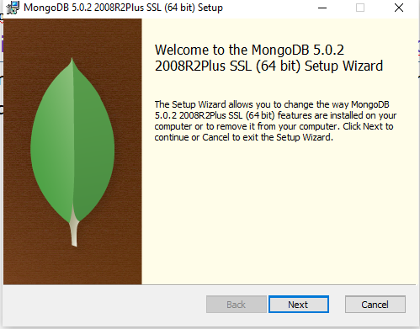
Environment – Install and configure MongoDB
From the Downloads, choose windows package installer : mongodb-windows-x86_64-5.0.2-signed.msi .The Windows Installer image shown below guides you through the installation process .

Slide 25
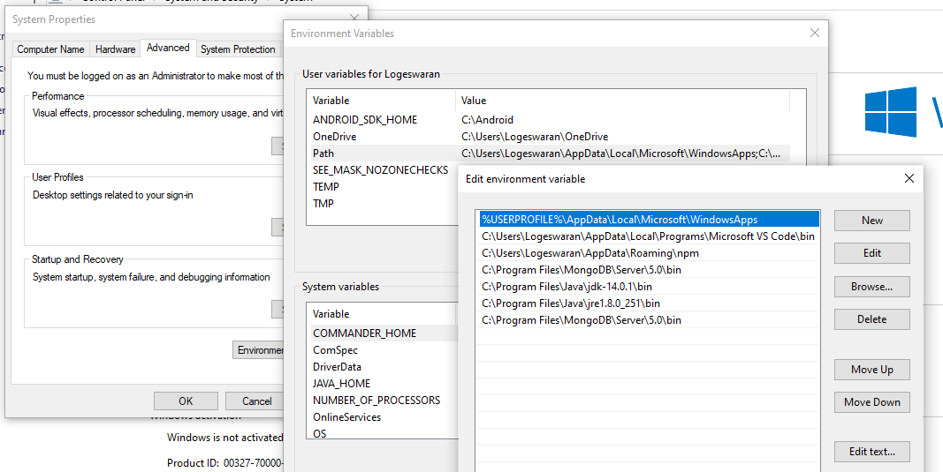
Environment – Install and configure MongoDB
After Installing , configure the path of the server
Find the folder in the location: C:\Program Files\MongoDB\Server\5.0\bin, edit the
Environment path variable to include the above path

Slide 26
Environment – Install and configure MongoDB
In the bin Folder of the path ,C:\Program Files\MongoDB\Server\5.0\bin, two .exe files named :
mongod(server) - “Mongo Daemon”,which manages all the MongoDB server tasks. For instance, accepting requests, responding to client, and memory management.
mongo(client) - command line shell that can interact with the client (for example, system administrators and developers).

Slide 27
Environment – Run MongoDB
Step1 : Set up the MongoDB environment
MongoDB requires a data directory to store all data.
Create default data directory path in C drive , C:\data\db, from which you start MongoDB.
Alternate path for data files can also be specified using the -- dbpath option as below:
"C:\Program Files\MongoDB\Server\5.0\bin\mongod.exe" --dbpath d:\test\mongodb\data

Slide 28
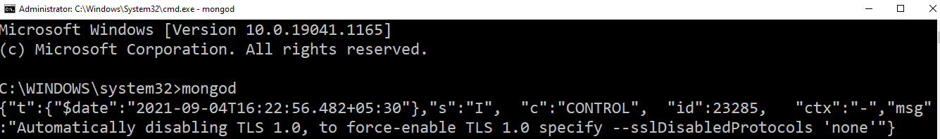
Environment – Run MongoDB
Step 2 : Start MongoDB from the command prompt with the command mongodb.

Slide 29
Environment – Run MongoDB
Step 2 : Start MongoDB from the command prompt with the command mongodb.

Slide 30
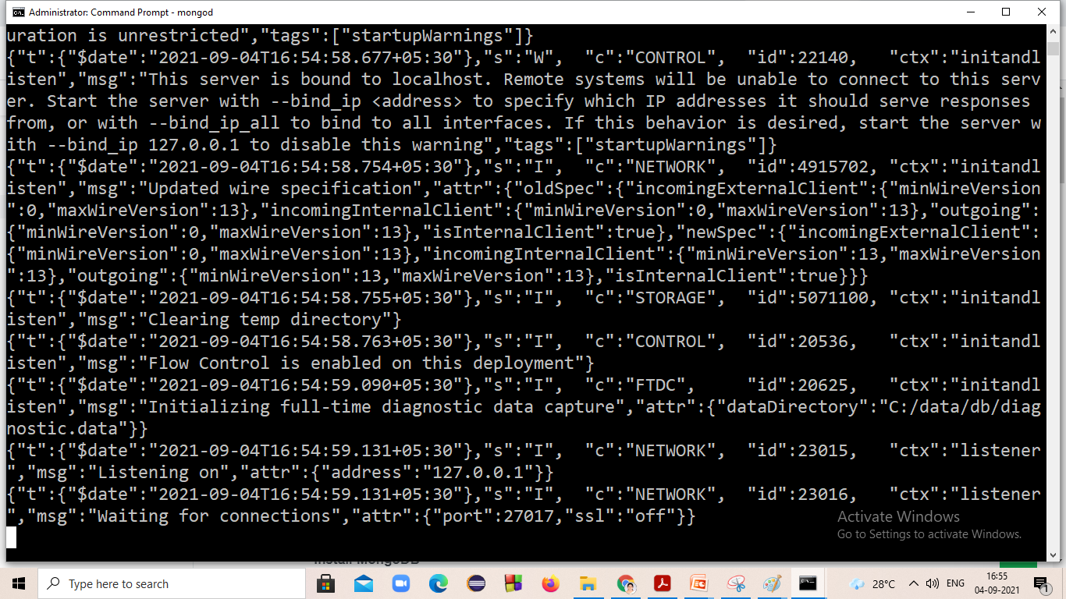
Environment – Run MongoDB
Step 3 : Verify that MongoDB has started successfully by checking the process output for the following line: waiting for connections on port 27017

Slide 31
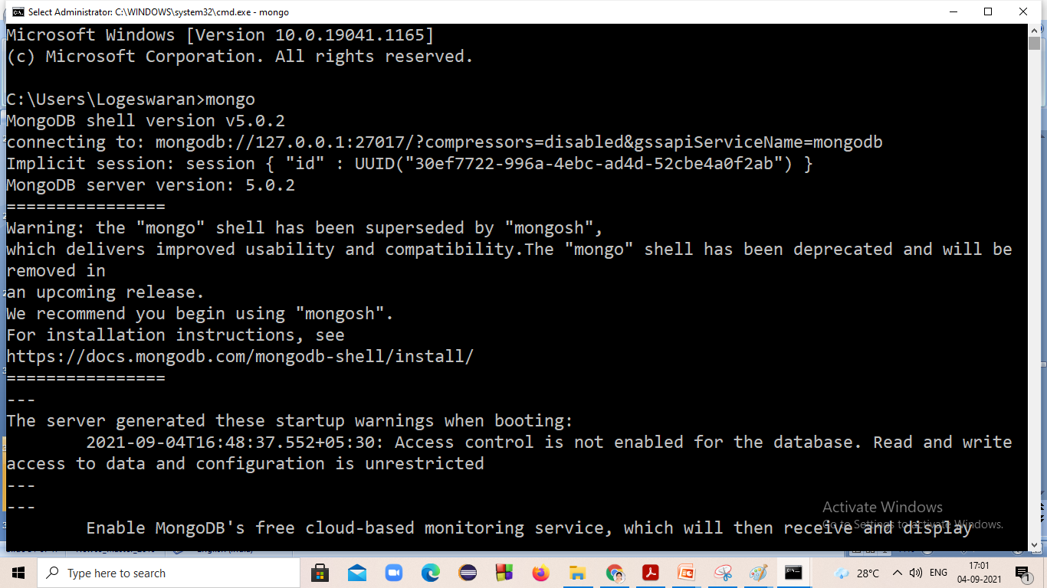
Environment – Run MongoDB
Step 4 :Connect to MongoDB server,open another command prompt and type mongo

Slide 32


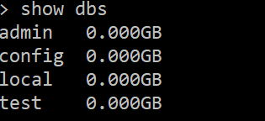
MongoDB – Basic Commands
Create Database
Syntax :
Example :
To check your currently selected database, use the command db
To view the database list,use the command show dbs
use<database_name>

Slide 33
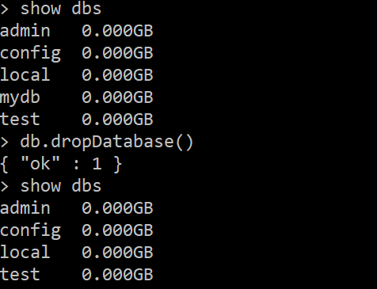
MongoDB – Basic Commands
Drop Database
Syntax :
Example :
db.dropDatabase()

Slide 34
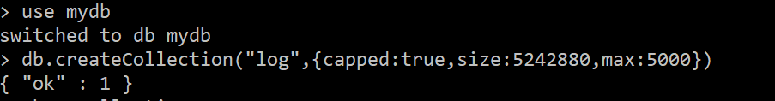
MongoDB – Basic Commands
Create Collection
Syntax :
Example :
db.createCollection(name, options)
Parameter | Type | Description
name | string | Collection name
options | document | Optional. Configuration options for creating a capped collection, preallocating space in a new collection.

Slide 35
MongoDB – Basic Commands
Create Collection : List of options
For more options refer the link: https://docs.mongodb.com/manual/reference/method/db.createCollection/
Field | Type | Description
capped | boolean | Optional. If true, enables a capped collection. Capped collection is a fixed size collection that automatically overwrites its oldest entries when it reaches its maximum size. If you specify true, you need to specify size parameter also.
autoIndexID | boolean | Optional. Specify false to disable the automatic creation of an index on the _id field.
size | number | Optional. Specifies a maximum size in bytes for a capped collection. If capped is true, then you need to specify this field also.
max | number | Optional.Specifies the maximum number of documents allowed in the capped collection.

Slide 36
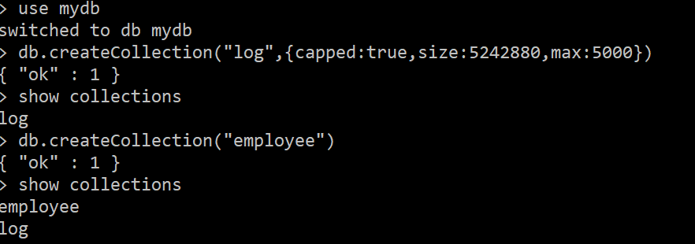
MongoDB – Basic Commands
The created collections can be checked using show collections command

Slide 37
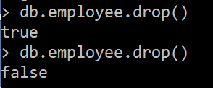
MongoDB – Basic Commands
Drop Collection
Syntax :
Example :
db.<collection_name>.drop()
when successfully drops a collection.
when collection to drop does not exist.

Slide 38
MongoDB – CRUD Operations
Insert Document/Documents
Syntax :
db.<collection_name>.insert(
<document or array of documents>,
{
writeConcern: <document>,
ordered: <boolean>
}
)
The insert() returns an object that contains the status of the operation.
Returns:
A WriteResult object for single inserts.
A BulkWriteResult object for bulk inserts.

Slide 39
MongoDB – CRUD Operations
Insert Document/Documents
Parameter | Type | Description
document | document or array | document or array of documents to insert into the collection.
writeConcern | document | Optional . A document expressing the write concern.
ordered | boolean | Optional. If true, perform an ordered insert of the documents in the array, and if an error occurs with one of documents, MongoDB will return without processing the remaining documents in the array. If false, perform an unordered insert, and if an error occurs with one of documents, continue processing the remaining documents in the array. Defaults to true.

Slide 40
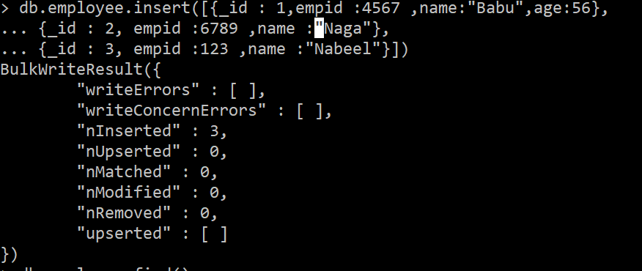
MongoDB – CRUD Operations
Insert Document/Documents – Example
Insert Single document
Insert Multiple documents

Slide 41
MongoDB – CRUD Operations
Insert Document/Documents – Example
“ _id ” field is a unique identifier for a document in a collection. It is required in every MongoDB document.
If “_id ” field is not specified while inserting,mongoDB will create “_id” field and assign it a unique ObjectId() value
“_id “ : 2 field:value was given while inserting the document

Slide 42
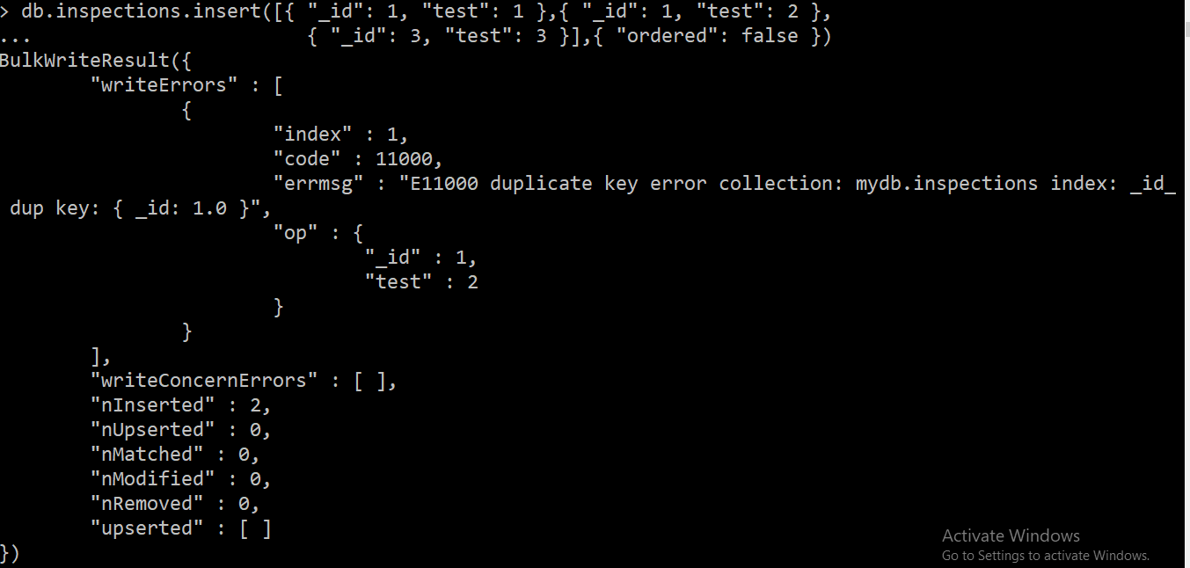
MongoDB – CRUD Operations
Insert Document/Documents – Order & Errors - Example
Perform an unordered insert

Slide 43
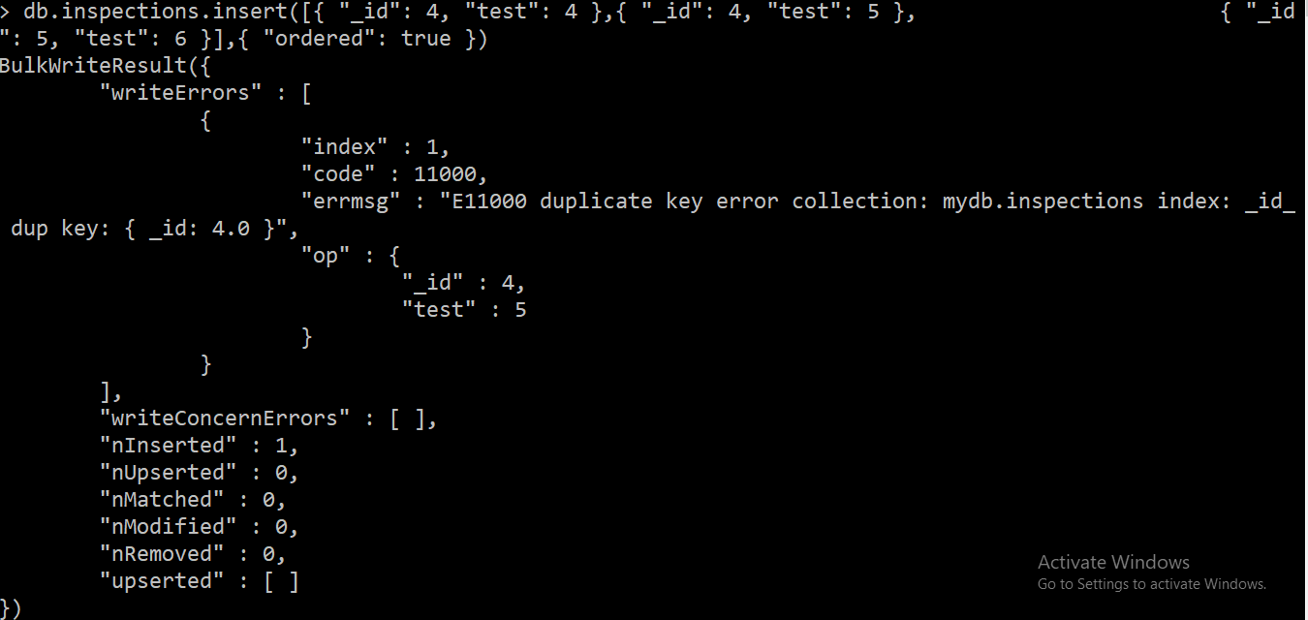
MongoDB – CRUD Operations
Insert Document/Documents – Order & Errors - Example
Perform an ordered insert

Slide 44
MongoDB – CRUD Operations
Insert Document/Documents
Syntax :
db.<collection_name>.insertOne(
<document>,
{
writeConcern: <document>,
ordered: <boolean>
}
)
The insert() returns a document that contains
A boolean acknowledged as true if the operation ran with write concern or false if
write concern was disabled.
A field insertedId with the _id value of the inserted document.

Slide 45
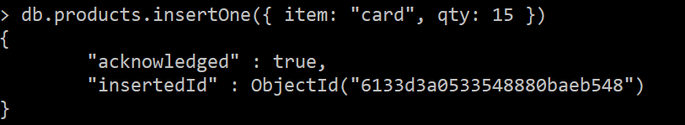
MongoDB – CRUD Operations
Insert Document/Documents
Example :

Slide 46
MongoDB – CRUD Operations
Insert Document/Documents
Syntax :
db.<collection_name>.insertMany(
[ <document 1> , <document 2>, ... ],
{
writeConcern: <document>,
ordered: <boolean>
}
)
The insert() returns a document that contains
A boolean acknowledged as true if the operation ran with write concern or false if
write concern was disabled.
A field insertedId with the _id value of the inserted document.

Slide 47
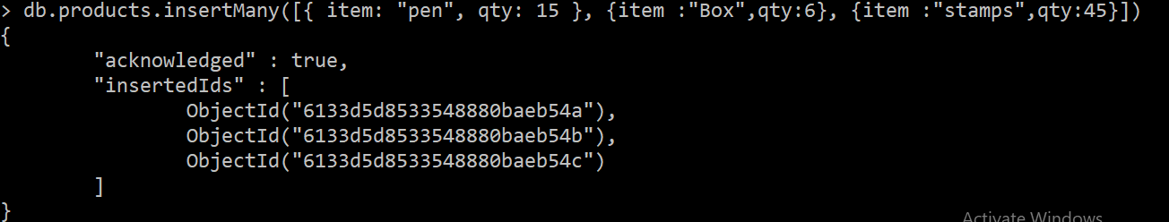
MongoDB – CRUD Operations
Insert Document/Documents
Example :

Slide 48
How does the value of _id get assigned to a document?
When a document is inserted a random field is picked to serve as the _id field.
You can select a non ObjectId type value when inserting a new document, as long as that value is unique to this collection.
_id field values are sequential integer values.
It is automatically generated as an ObjectId type value.
Both b) and d)

Slide 49
Select all true statements from the following list:
If a document is inserted without a provided _id value, then that document will fail to be inserted and cause a write error.
MongoDB can store duplicate documents in the same collection, as long as their _id values are different
If a document is inserted without a provided _id value, then that field and value will be automatically generated for the inserted document before insertion.
Both b) and c)

Slide 50
Which of the following commands will successfully insert 3 new documents into an empty pets collection?
db.pets.insert([{ "pet": "cat" }, { "pet": "dog" }, { "pet": "fish" }])
db.pets.insert([{ "_id": 1, "pet": "cat" }, { "_id": 1, "pet": "dog" }, { "_id": 3, "pet": "fish" }, { "_id": 4, "pet": "snake" }], { "ordered": true })
db.pets.insert([{ "_id": 1, "pet": "cat" }, { "_id": 1, "pet": "dog" }, { "_id": 3, "pet": "fish" }, { "_id": 4, "pet": "snake" }], { "ordered": false })
db.pets.insert([{ "_id": 1, "pet": "cat" }, { "_id": 2, "pet": "dog" }, { "_id": 3, "pet": "fish" }, { "_id": 3, "pet": "snake" })
a), c) and d)

Slide 51
MongoDB – Operators
Query Selectors:
Comparison
Name | Description | Syntax & Example
$eq | Matches values that are equal to a specified value. | { <field> : { $eq: <value> } } db.inventory.find( { qty: { $eq: 20 } } )
$gt | Matches values that are greater than a specified value. | { <field> : { $gt: <value> } } db.inventory.find( { qty: { $gt: 20 } } )
$gte | Matches values that are greater than or equal to a specified value. | {field: {$gte: value} } db.inventory.update( { "carrier.fee": { $gte: 2 } }, { $set: { price: 9.99 } } )

Slide 52
MongoDB – Operators
Query Selectors:
Comparison
Name | Description | Syntax & Example
$in | Matches any of the values specified in an array. | { field : { $in: [<value1>, <value2>, ... <valueN> ] } } db.inventory.update({ tags: { $in: ["appliances", "school"] } },{ $set: { sale:true } } )
$lt | Matches values that are less than a specified value. | {field: {$lt: value} } db.inventory.find( { qty: { $lt: 20 } } )
$lte | Matches values that are less than or equal to a specified value. | {field: {$lte: value} } db.inventory.update( { "carrier.fee": { $lte: 5 } }, { $set: { price: 9.99 } } )

Slide 53
MongoDB – Operators
Query Selectors:
Comparison
Name | Description | Syntax & Example
$ne | Matches all values that are not equal to a specified value. | {field: {$ne: value} } db.inventory.find( { qty: { $ne: 20 } } )
$nin | Matches values that are less than a specified value. | { field: { $nin: [ <value1>, <value2> ... <valueN> ]} } db.inventory.find( { qty: { $nin: [ 5, 15 ] } } )

Slide 54
MongoDB – Operators
Query Selectors:
Logical
Name | Description | Syntax & Example
$and | Joins query clauses with a logical AND returns all documents that match the conditions of both clauses. | {$and: [{ <expr1> },{ <expr2> } , ... ,{<exprN>}]} db.inventory.find( { $and: [ { price: { $ne: 1.99 } }, { price: { $exists: true } } ] } )
$not | Inverts the effect of a query expression and returns documents that do not match the query expression. | { field: { $not: { <operator-expression> } } } db.inventory.find( { price: { $not: { $gt: 1.99 } } } )
$nor | Joins query clauses with a logical NOR returns all documents that fail to match both clauses. | { $nor: [ { <expression1> }, { <expression2> }, ... { <expressionN> } ] } db.inventory.find( { $nor: [ { price: 1.99 }, { sale: true } ] } )

Slide 55
MongoDB – Operators
Query Selectors:
Logical
Name | Description | Syntax & Example
$or | Joins query clauses with a logical OR returns all documents that match the conditions of either clause. | {$or: [{ <expr1> },{ <expr2> } , ... ,{<exprN>}]} db.inventory.find( { $or: [ { quantity: { $lt: 20 } }, { price: 10 } ] } )

Slide 56
MongoDB – Operators
Query Selectors:
Element
Name | Description | Syntax & Example
$exists | Matches documents that have the specified field. | { field: { $exists: <boolean> } } db.inventory.find( { qty: { $exists: true, $nin: [ 5, 15 ] } } )

Slide 57
MongoDB – Operators
Query Selectors:
Evaluation
Name | Description | Syntax & Example
$expr | Allows use of aggregation expressions within the query language. | { $expr: { <expression> } } db.monthlyBudget.find( { $expr: { $gt: [ "$spent" , "$budget" ] } } )
$mod | Performs a modulo operation on the value of a field and selects documents with a specified result. | { field: { $mod: [ divisor, remainder ] } } db.inventory.find( { qty: { $mod: [ 4, 0 ] } } )
$regex | Selects documents where values match a specified regular expression. | { <field>: { $regex: /pattern/<options> } } db.products.find( { sku: { $regex: /^ABC/i } } )

Slide 58
MongoDB – CRUD Operations
In mongoDB,db.collection.find() method is used to select documents in a collection and returns a cursor to the selected documents.
If the method is used in the mongo shell, shell will automatically iterate the cursor to display up to 20 documents in the collection.
if you want to continue then type it or you can manually iterate the result of the find() method by assigning the returned cursor to a variable with the var keyword.
The behaviour of the methods can be changed using cursor methods

Slide 59
MongoDB – CRUD Operations
find () method
Syntax :
db.<collection_name>.find(query, projection)
query : {<field>:<value>/{$queryoperator:<value>},..}
projection : { <field1>: <value>, <field2>: <value>, ... }
Return :
A cursor to the documents that match the query criteria.
When the find() method "returns documents," the method is actually returning a
cursor to the documents.

Slide 60
MongoDB – CRUD Operations
find () method
For more details on query and projection parameters refer the below link
https://docs.mongodb.com/manual/reference/operator/
https://docs.mongodb.com/manual/reference/method/db.collection.find/#std-label-method-find-projection
Parameter | Type | Description
query | document | Optional. Specifies selection filter using query operators. To return all documents in a collection, omit this parameter or pass an empty document ({}).
projection | document | Optional. Specifies the fields to return in the documents that match the query filter. To return all fields in the matching documents, omit this parameter.

Slide 61
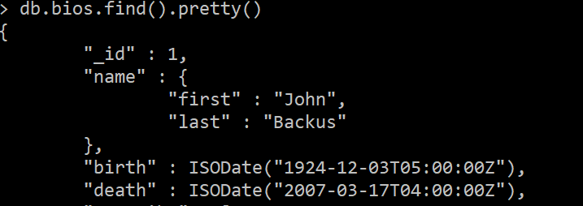
MongoDB – CRUD Operations
Examples :
Find all documents in the collection : db.bios.find()
2) Find all documents in the collection : db.bios.find().pretty()(pretty method display the output in a formatted way)

Slide 62
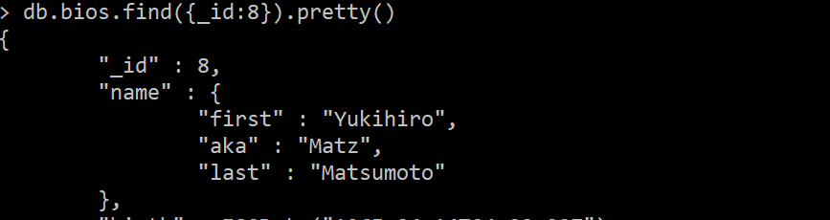
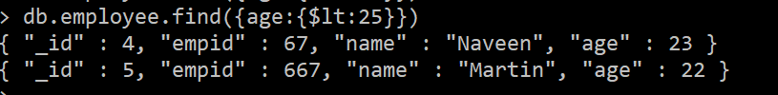
MongoDB – CRUD Operations
Examples :
3) Find all documents in the collection that matches the filter query(_id =3)
Find all documents in the collection that matches the filter based on operators (age<25)

Slide 63
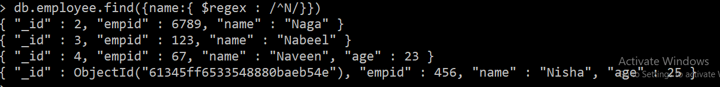
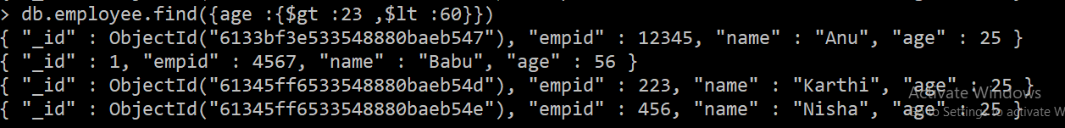
MongoDB – CRUD Operations
Examples :
5) Find all documents in the collection that matches the filter based on operators(like N%)
6 ) Find all documents in the collection that matches the query for ranges(age>25 and age<60)

Slide 64
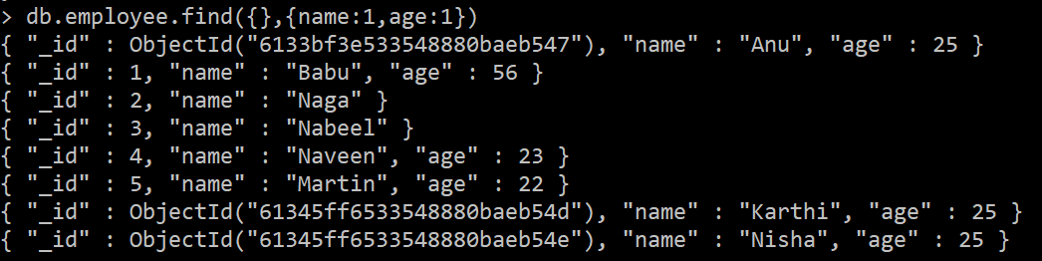
MongoDB – CRUD Operations
Examples :
7) Query for documents that matches multiple condition ( empid>600 and age does not exists)
8) Query the documents based on Projections parameter, specifies which fields to return

Slide 65
MongoDB – CRUD Operations
In mongoDB,db.collection.update() method,modifies an existing document or documents in a collection.
The method can modify specific fields of an existing document or documents or replace an existing document entirely, depending on the update parameter.
By default, the db.collection.update() method updates a single document.
Include the option multi: true to update all documents that match the query criteria.

Slide 66
MongoDB – CRUD Operations
Syntax:
db.<collection_name>.update(
<query>,
<update>,
{
upsert: <boolean>,
multi: <boolean>,
writeConcern: <document>,
collation: <document>,
arrayFilters: [ <filterdocument1>, ... ],
hint: <document|string>,
let: <document>
}
)
Return :
The method returns a WriteResult document that contains the status of the
operation.

Slide 67
MongoDB – CRUD Operations
Syntax:
For more details refer: https://docs.mongodb.com/manual/reference/method/db.collection.update/
Parameter | Type | Description
query | document | Required.The selection criteria for the update. The same query selectors as in the find() method are available.
update | document | Required. The modifications to apply. Can be one of the following: Update document/Replace document/Aggregation pipeline
upsert | boolean | Optional.If set to true, creates a new document when no document matches the query criteria. The default value is false, which does not insert a new document when no match is found.
multi | boolean | Optional.If set to true, updates multiple documents that meet the query criteria. If set to false, updates one document. The default value is false.
writeConcern | document | Optional.A document expressing the write concern. Omit to use the default write concern.

Slide 68
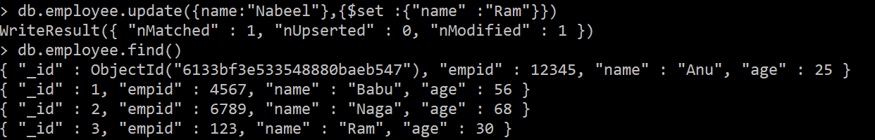
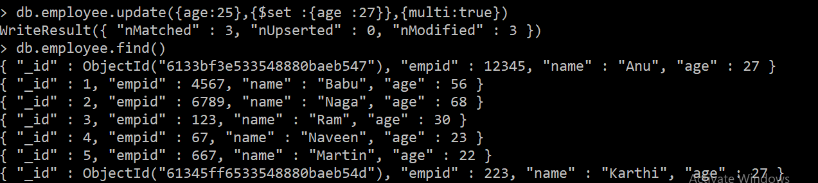
MongoDB – CRUD Operations
Example :
1) Updating a single document using operator Expression $set
2)Updating multiple documents using operator Expression $set and with multi option set to true

Slide 69
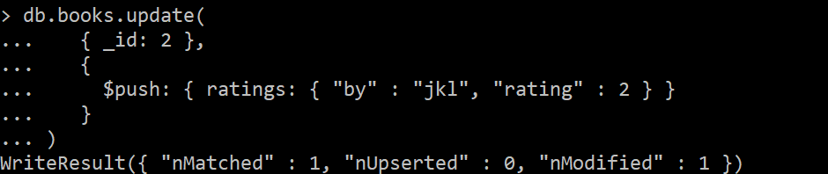
MongoDB – CRUD Operations
Example :
3) Updating a document using operator Expression $push- update operator to append a new object
4 )Updating a document by removing field using operator Expression $unset

Slide 70
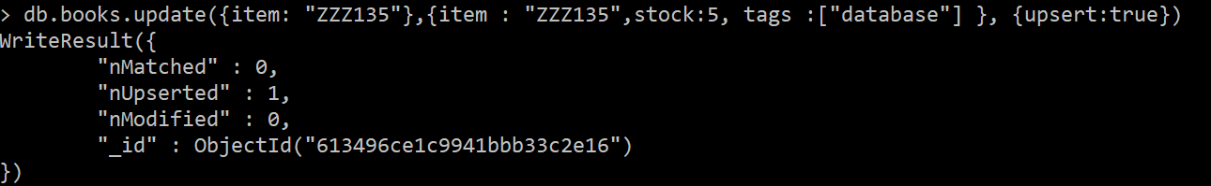
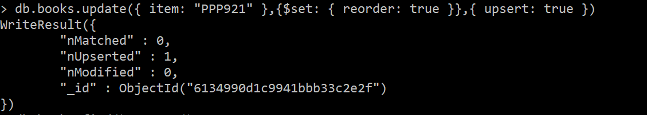
MongoDB – CRUD Operations
Example :
5) Updating a document with Upsert option set to true : Insert a new document if No Match Exists
6 ) Updating a document with Upsert option set to true : Insert a new document if No Match Exists with Operator Expressions($set)

Slide 71
MongoDB – CRUD Operations
In mongoDB,db.collection.remove() removes the document from the collection.
Syntax
db.<collection_name>.remove(
<query>,
{
justOne: <boolean>,
writeConcern: <document>,
collation: <document>,
let: <document>
}
)
Return :
The method returns a WriteResult document that contains the status of the
operation.

Slide 72
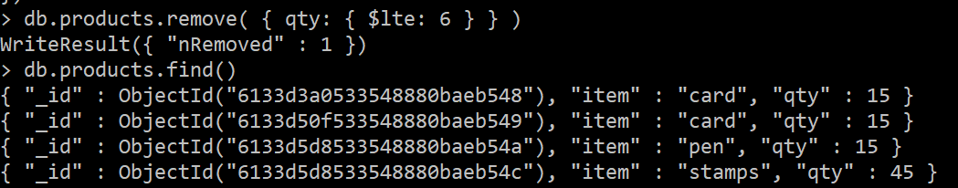
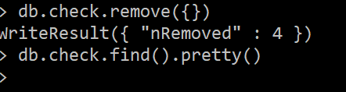
MongoDB – CRUD Operations
Examples :
1) Removes the document based on the condition query
2 ) Removes all the documents with empty() argument in the remove method

Slide 73
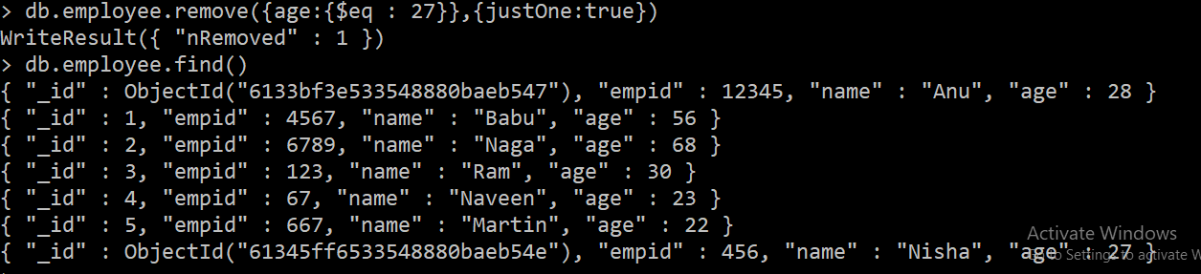
MongoDB – CRUD Operations
Examples :
3) Removes Single Document that Matches a Condition using just One parameter

Slide 74
MongoDB – Aggregation
Aggregation operations process data records and return computed results.
Aggregation operations group values from multiple documents together, and can perform a variety of operations on the grouped data to return a single result.
MongoDB provides two ways to perform aggregation:
Aggregation Pipeline
Single purpose aggregation methods

Slide 75
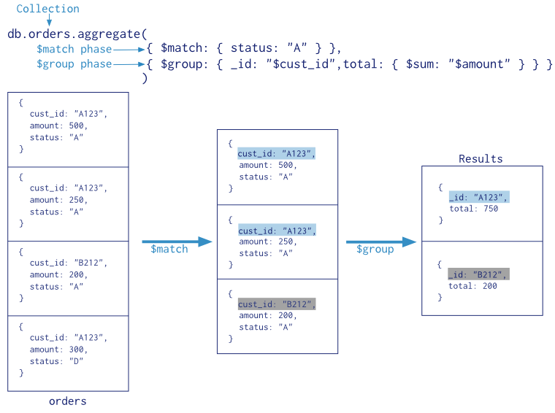
MongoDB – Aggregation Pipeline

Slide 76
MongoDB – Aggregation Pipeline
Syntax
db.collection.aggregate([
{ $stage1: { <stage1_operator> } },
{ $stage2: { <stage2_operator> } },
// Additional stages as needed
])

Slide 77
MongoDB – Aggregation Pipeline
Example
db.employee.aggregate([
{
$group: {
_id: "$location", // Grouping by location
averageAge: { $avg: "$age" } // Calculating the average age
}
}
]);

Slide 78
MongoDB – Aggregation Pipeline
In mongodb,db.collection.aggregate(), calculates aggregate values for the data in a collection
Aggregation expressions come in one of three primary flavours:
Operators. Accessed as an object with a $ prefix followed by the operator function name. The "dollar-operator-name" is used as the main key for the object. Examples: {$arrayElemAt: ...}, {$cond: ...}, {$dateToString: ...}
Field Paths. Accessed as a string with a $ prefix followed by the field's path in each record being processed. Examples: "$account.sortcode", "$addresses.address.city“
Variables. Accessed as a string with a $$ prefix followed by the fixed name

Slide 79
MongoDB – Aggregation Pipeline
Syntax:
db.<collection_name>.aggregate(pipeline, options)
Parameter | Type | Description
pipeline | array | Required. A sequence of data aggregation operations or stages. The method can still accept the pipeline stages as separate arguments instead of as elements in an array; however, if you do not specify the pipeline as an array, you cannot specify the options parameter.
options | document | Optional. Additional options that aggregate() passes to the aggregate command.

Slide 80
MongoDB – Aggregation Pipeline
Pipeline Aggregation Stages
For more details refer:
https://docs.mongodb.com/manual/reference/operator/aggregation-pipeline/
Parameter | Description
$match | Operator filters the documents to pass only those documents that match the specified condition(s) to the next pipeline stage
$group | Groups input documents by the specified _id expression and for each distinct grouping, outputs a document.
$limit | Limits the number of documents passed to the next stage in the pipeline
$sort | Sorts all input documents and returns them to the pipeline in sorted order.
$count | Contains a count of the number of documents

Slide 81
MongoDB – Aggregation
$count (aggregation) - Passes a document to the next stage that contains a count of the number of documents input to the stage.
<string> is the name of the output field which has the count as its value
2. $match(aggregation) - Filters the documents to pass only the documents that match the specified condition(s) to the next pipeline stage.
Prototype form :{ $count: <string> }
Prototype form :{ $match: { <query> } }

Slide 82
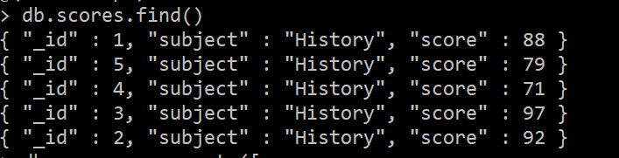
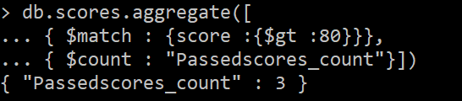
MongoDB – Aggregation
Example : consider the collection scores
Query the collection to display the count of scores more that 80 with name “passedscores_count”

Slide 83
MongoDB – Aggregation
3. $group(aggregation) - Groups input documents by the specified _id expression and for each distinct grouping, outputs a document.
{
$group:
{
_id: <expression>, // Group By Expression
<field1>: { <accumulator1> : <expression1> },
...
}
}

Slide 84
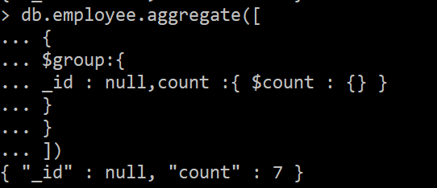
MongoDB – Aggregation
Example : Count the number of documents in the given collection

Slide 85
Thank you

